Slide 1

EMPLOYEE ATTRITION
Team Details
Mohan Deep
Peter Shyamal
Abirami
Harishiva K

Slide 2
Problem statement
Objective
A major problem in high employee attrition is its cost to an organization. Job postings, hiring processes, paperwork and new hire training are some of the common expenses of losing employees and replacing them.
Additionally, regular employee turnover prohibits your organization from increasing its collective knowledge base and experience over time.
This is especially concerning if your business is customer facing, as customers often prefer to interact with familiar people. Errors and issues are more likely if you constantly have new workers.
We analyze and predict the factors affecting the chances of attrition in an organization. We are building a suitable model for HR department to make appropriate decisions and to identify the trend of employee who opt voluntary resignation in an organization considering relevant features and parameters.

Slide 3
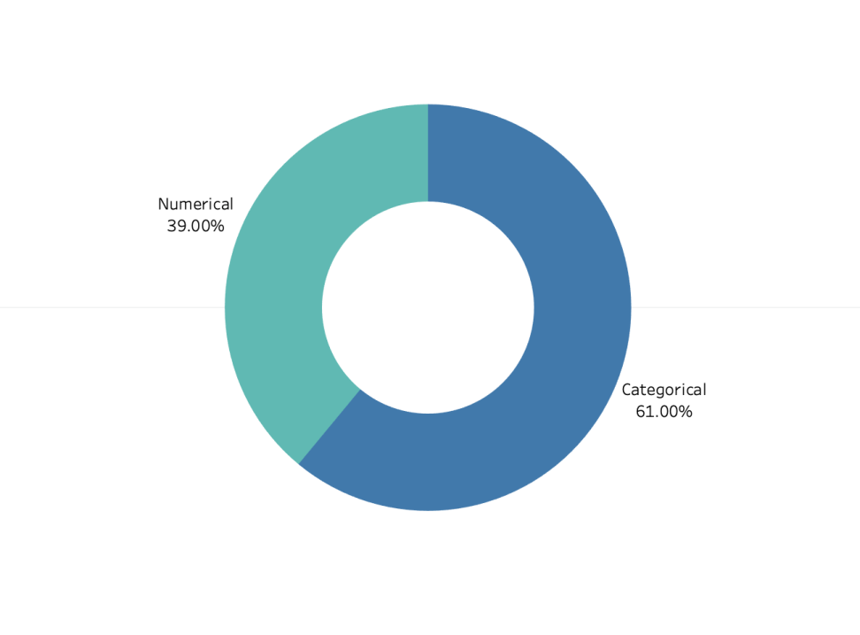
Data Description
Categorical and numerical columns
Data Shape
Number of rows: 23436
Number of columns: 36+1

Slide 4
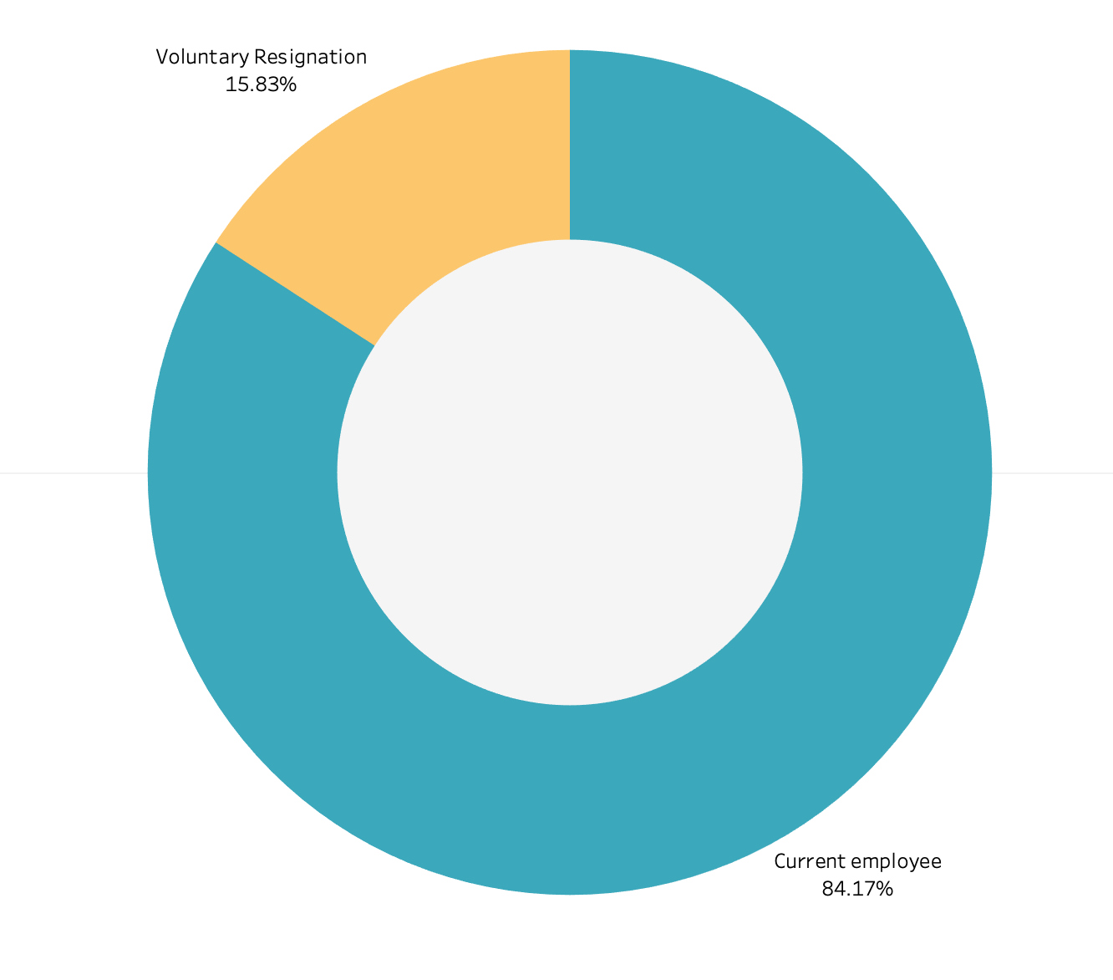
Data Exploration
Target variable
Classification Model
Attrition
0 - Current Employee
1 - Volunteer Resignation

Slide 5
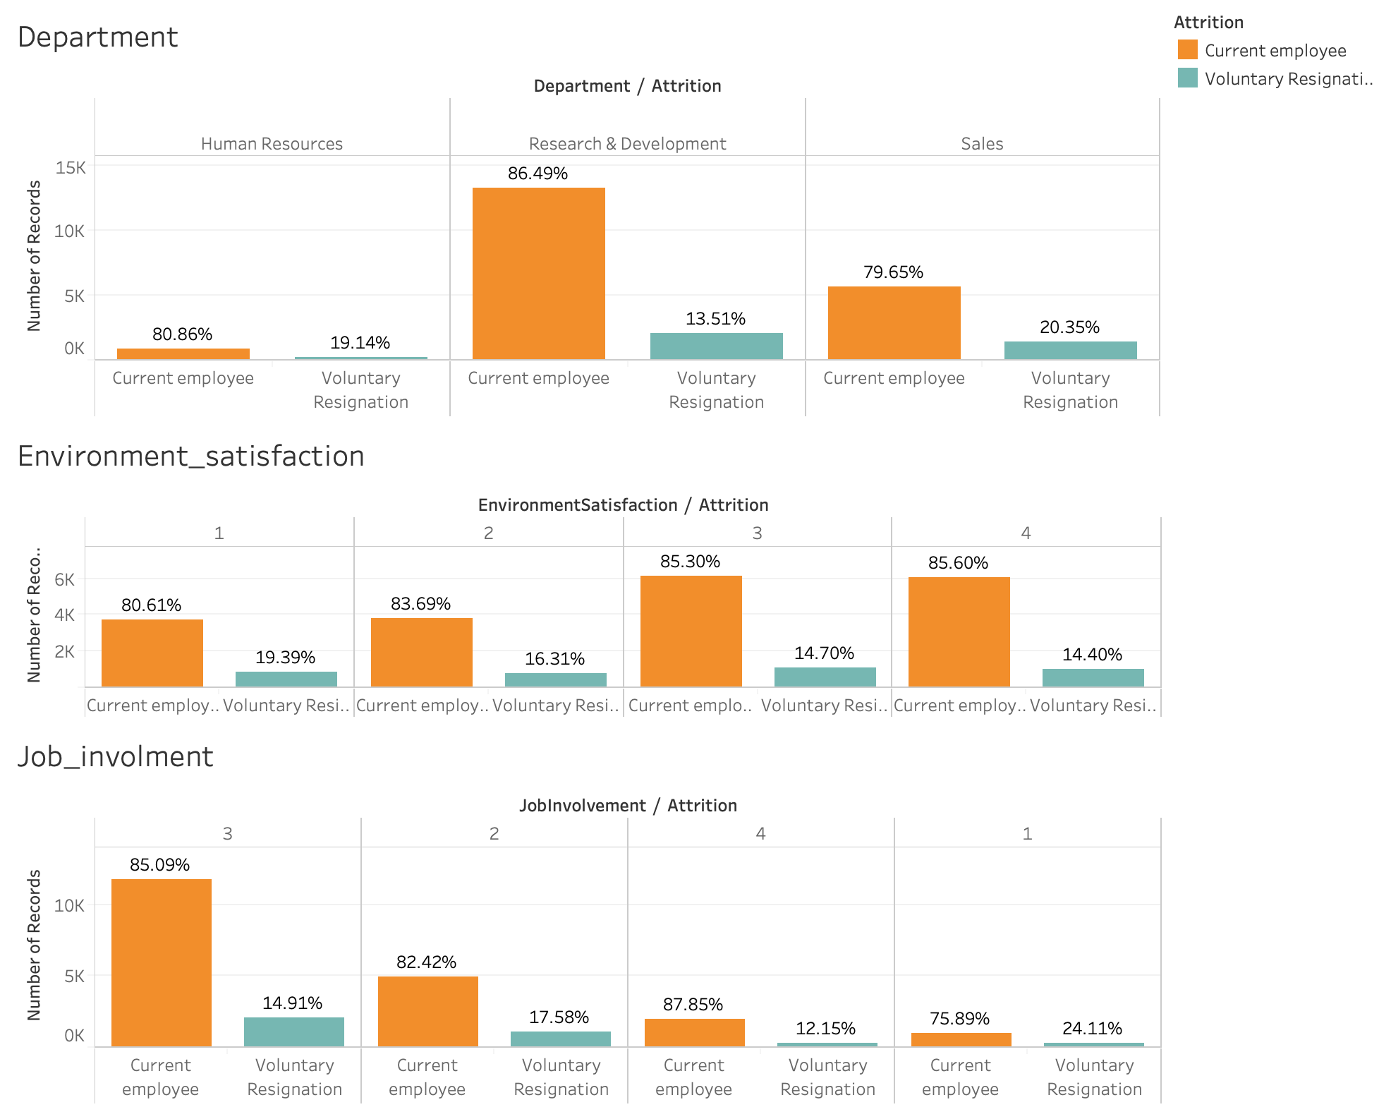
Department,Environment Satisfaction, Job Involvement vs Attrition

Slide 6
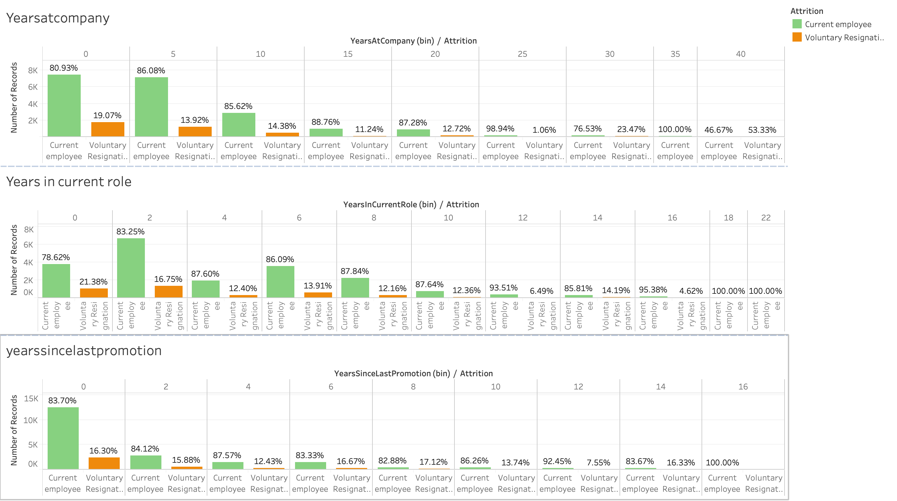
Years at Company, Years in current Role, Years since least vs Attrition

Slide 7
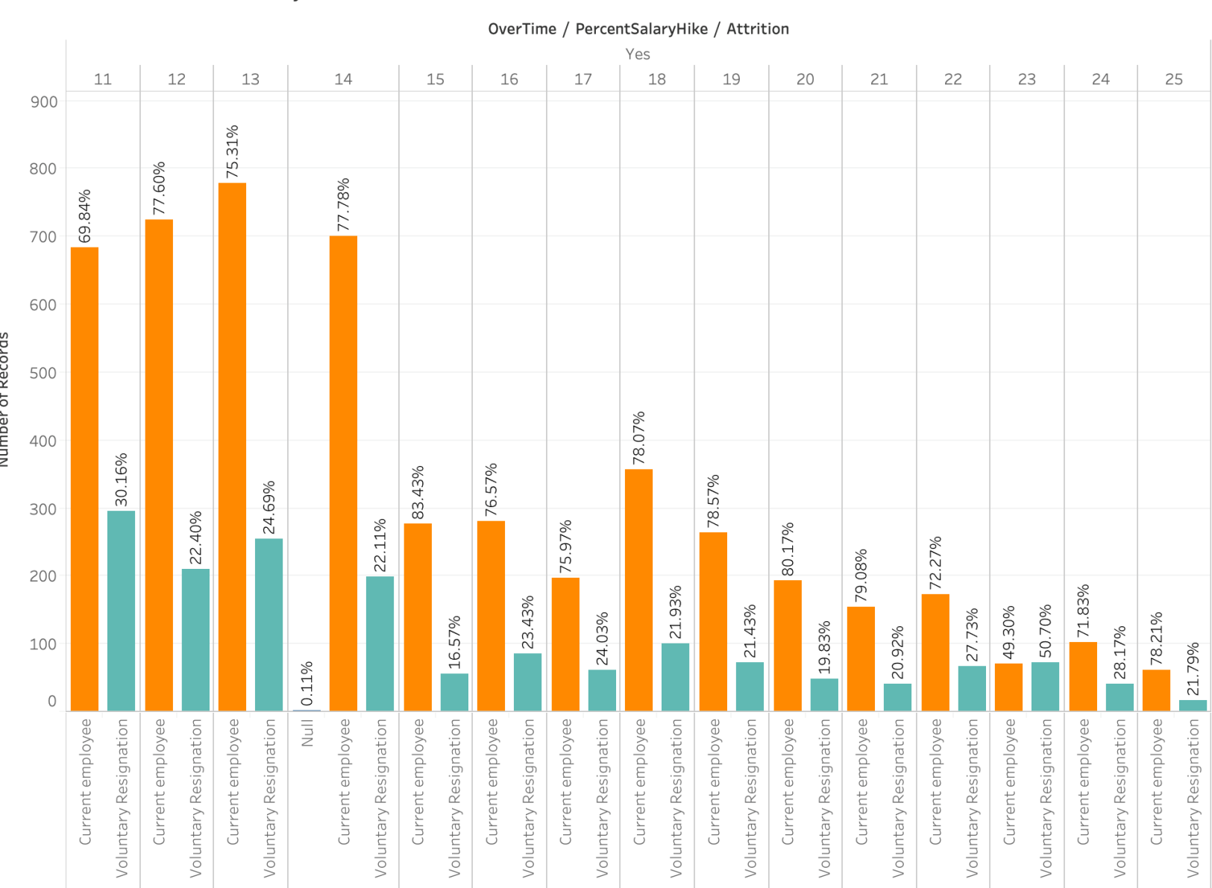
Over Time vs Percent Salary Hike vs Attrition

Slide 8
Inferences
Employees within the age range 20 to 30 are higher in the category of voluntary resignation. Employees from education field and technical degree are comparatively high in the category of voluntary resignation.
We observe a high resignation rate from employees who are single/married and travel frequently. With this we infer that the employees prefer fixed location.
High resignation rate is observed in employees who do over time and receive less percentage salary hike.

Slide 9
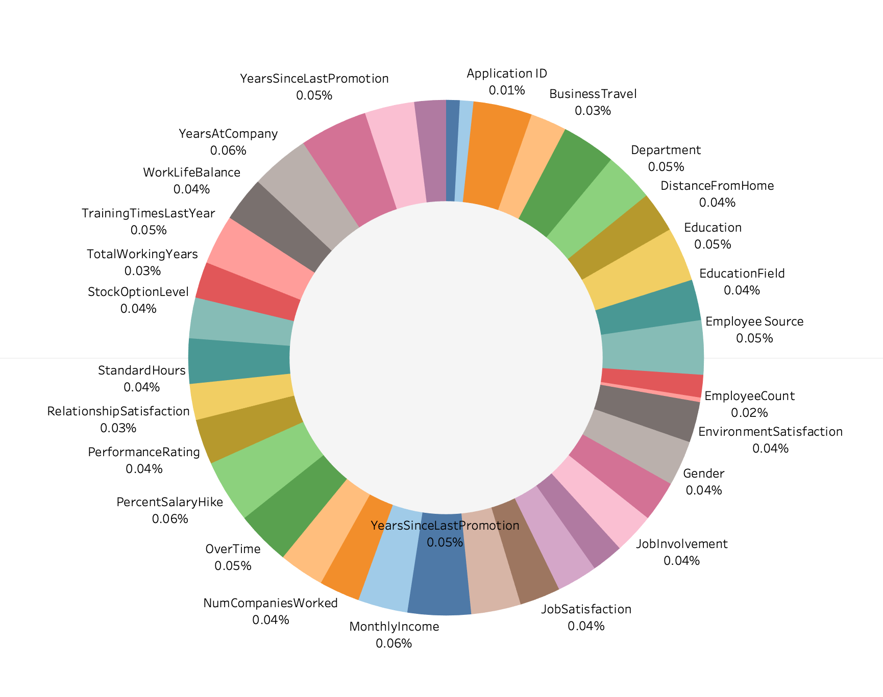
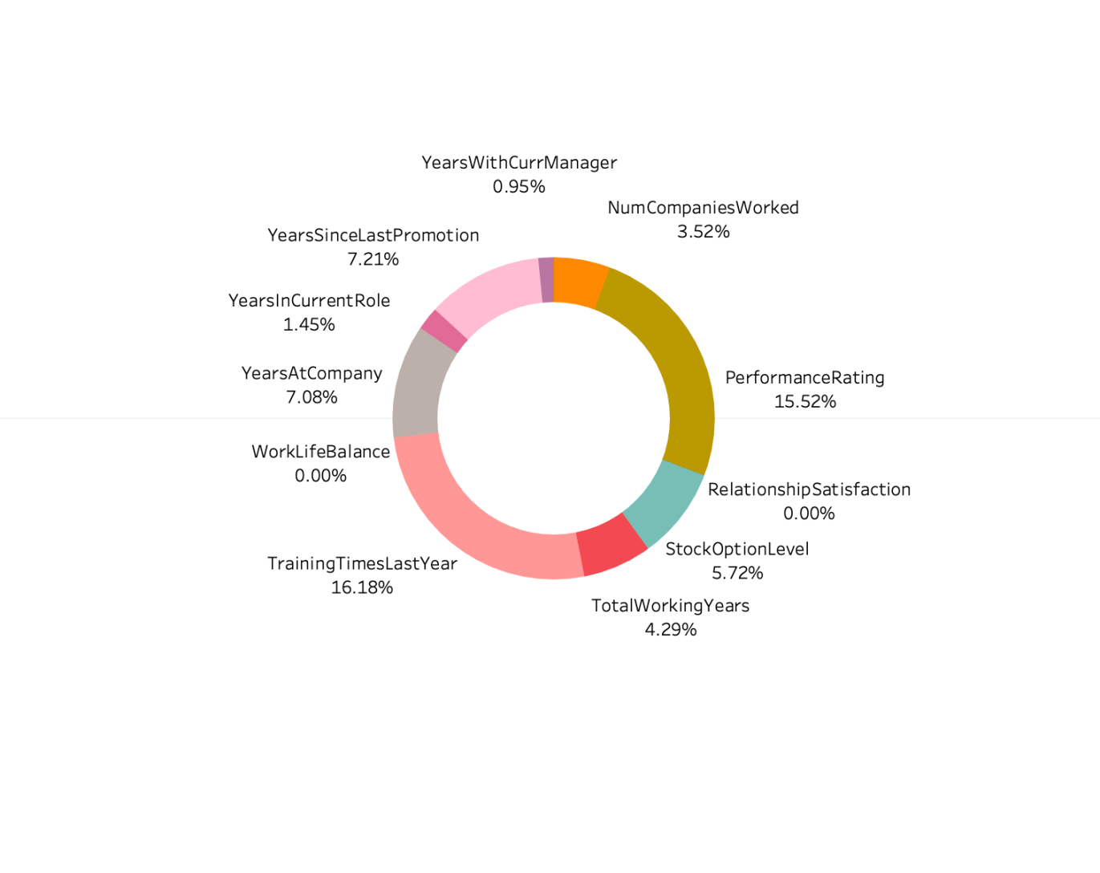
Data Preparation
Missing Values
Outliers

Slide 10
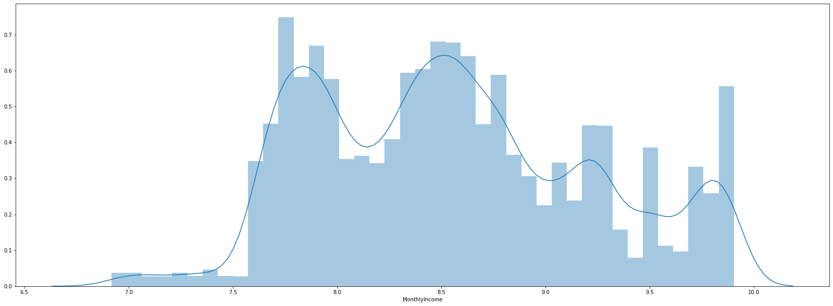
Data Transformations
Bucketing of columns:
LOG Transformation
· No. of companies worked · Performance Rating · Stock level option · Total years of working · Training times per year · Years at company · Years at current role · Years since last promotion · Years with current manager
Monthly Income

Slide 11
Data Modeling
Logistic Regression
Logistic Regression After smote
Logistic Regression After RFE
Naïve Bayes
Decision Tree
Pruned Decision Tree
Decision Tree GridSearchCV
Random Forest
Ada Boost Classifier
Bagging Classifier

Slide 12
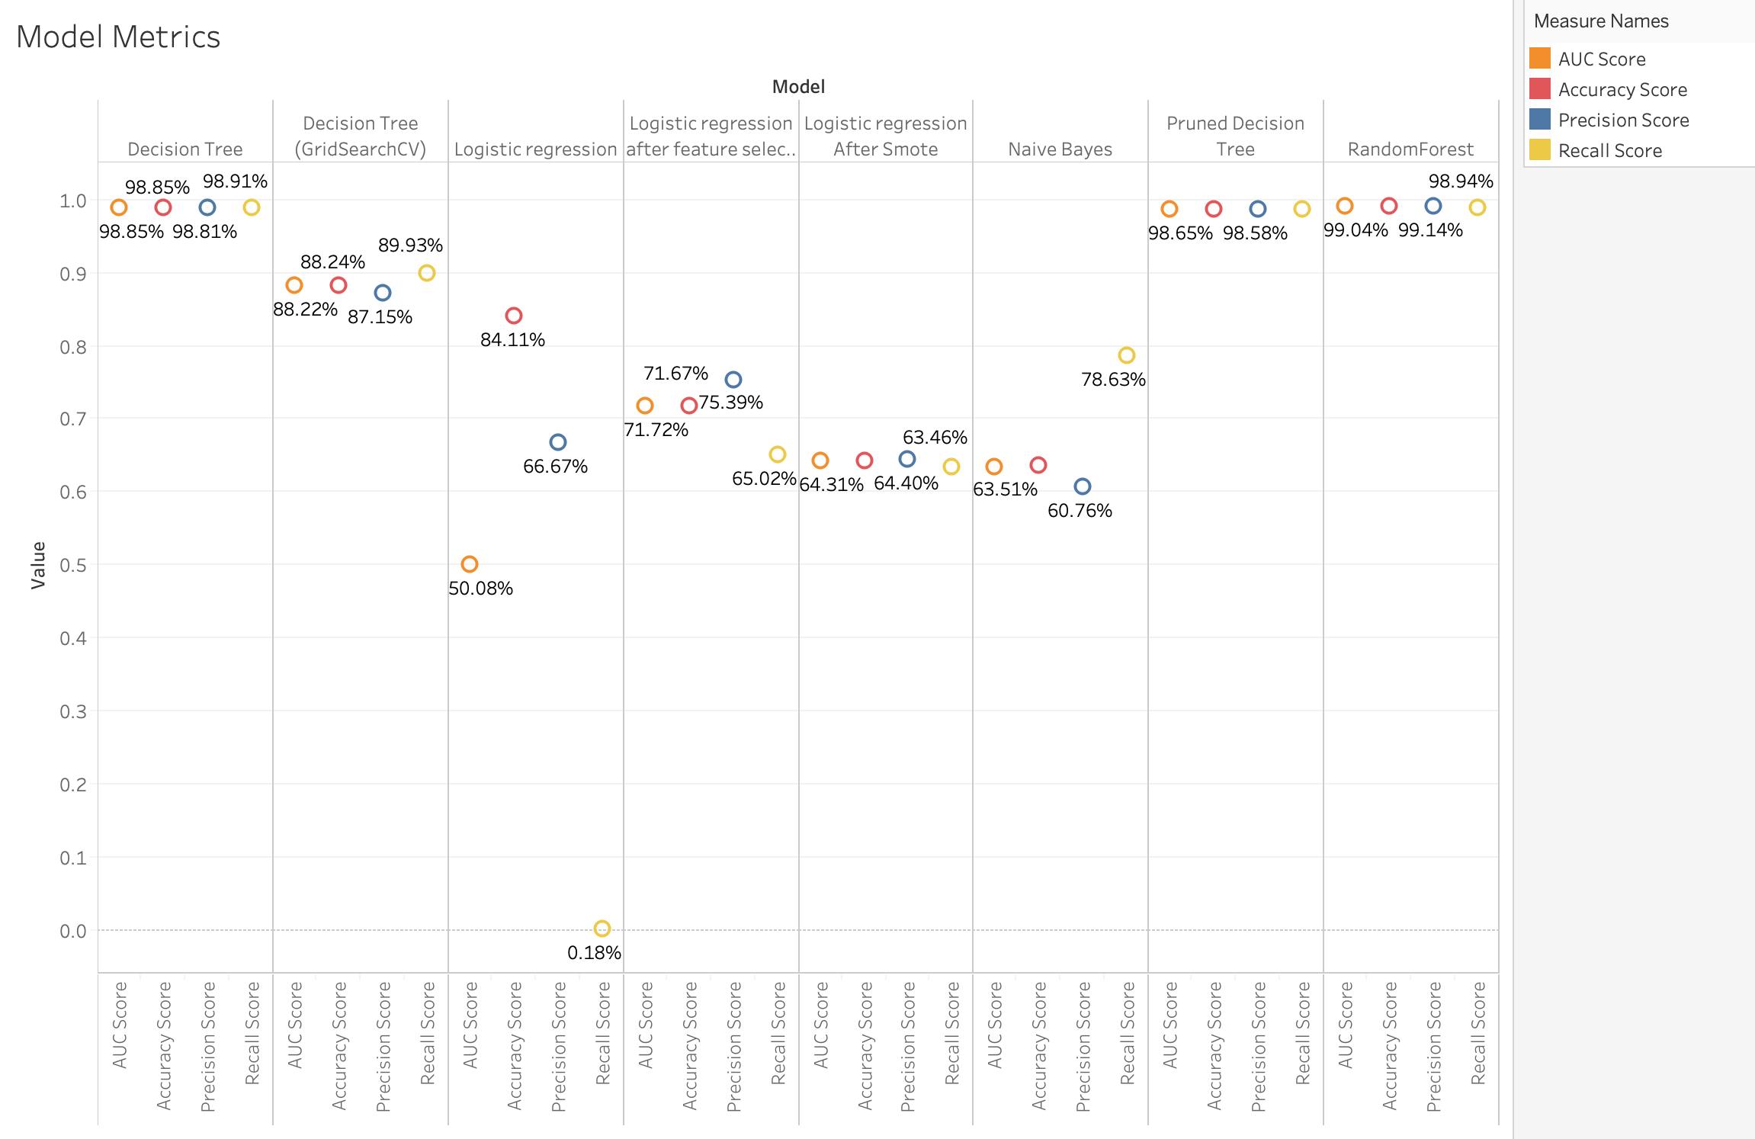
Model Evaluation

Slide 13
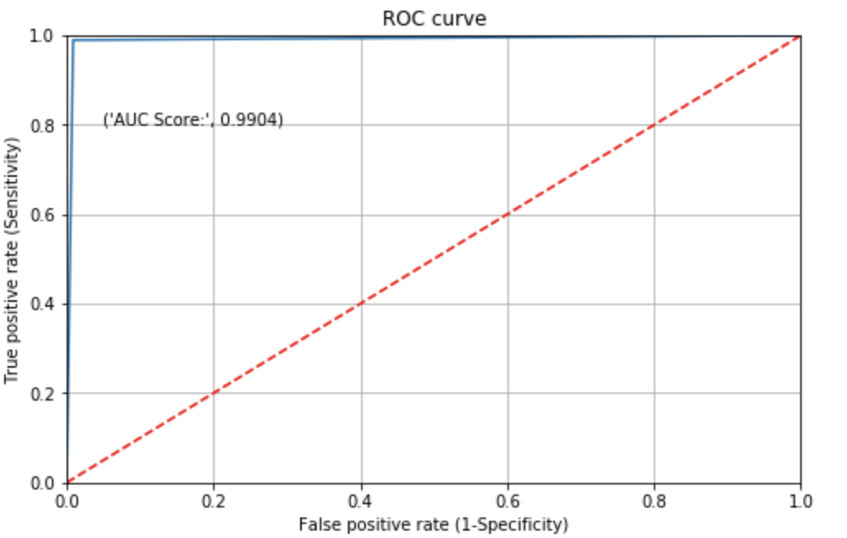
Final Model
Random Forest
Business Outcome
The HR department can benefit with our model by passing the employee data which helps them predict his/her voluntary resignation and the factors that contributes to the same.

Slide 14
Thank You!

